Slide 1
Schema Refinement and Normal Forms
Notes:
1
The slides for this text are organized into chapters. This lecture covers Chapter 19, on formal, dependency-driven database design..
Integrity constraints, in particular functional dependencies, play an important role in the design of database schemas. In particular, they can shed light on potential redundancies (and the problems that go with redundancy) in a relational schema. Typically, they are used to analyze the relational schema obtained by converting an ER diagram.
This chapter can be covered any time after the Foundations material (Chapters 1 to 5) is covered, at the instructor’s discretion. A good choice is to cover it after presenting all the implementation related material that is included in a course. This will allow a design sequence consisting of Chapters 19 and 20, and will enable the instructor to bring out the fact that design involves both redundancy analysis and performance considerations, and that these concerns should go hand-in-hand.

Slide 2
Database Design
Requirements Analysis
Conceptual Modeling (ER Model)
Logical Modeling (Relational Model)
Schema Refinement (Normalization)

Slide 3
Schema Refinement
Redundancy
Schema Refinement
  Minimizing Redundancy
  Functional Dependencies (FDs)
  Normalization using FDs
    First Normal Form (1NF)
    Second Normal Form (2NF)
    Third Normal Form (3NF)
    Boyce-Codd Normal Form (BCNF)
  Multivalued Dependencies (MVDs), Join Dependencies JDs)
  Normalization using MVDs and JDs
    Higher Normal Forms ( 4NF, 5NF)

Slide 4
Redundancy
Storing the same information in more than one place within a database
Redundant Storage: Some information is stored repeatedly
Update Anomalies : Inconsistencies are created unless each and every copy of the data is updated
Insertion Anomalies: It may not be possible to store certain information unless storing some other, unrelated, information as well
Deletion Anomalies: It may not be possible to delete certain information without loosing some other, unrelated, information as well
Normalization is done for “minimizing” redundancy

Slide 5
Anomalies
Instructor ( Instr_ID, Instr_name, Course, Credit)
Redundancy: Same course can be taught by several instructors, each time the credit for such course is repeated
Update Anomaly: Update information that DBMS from Semester I, 2008-2009 is 4.5 units course
Insert Anomaly: Cannot insert a new course credit unless an instructor is assigned to it
  Inversely - Cannot insert an instructor information unless she is assigned to a course to teach
Delete Anomaly: Last instructor available for teaching a course say Semantic Approaches leaves institute. The information that this course is a 3 credit course is also lost

Slide 6
Outline
Features of Good Relational Design
Functional Dependencies
Decomposition Using Functional Dependencies
Normal Forms
Functional Dependency Theory
Algorithms for Decomposition using Functional Dependencies
Decomposition Using Multivalued Dependencies
More Normal Form
Atomic Domains and First Normal Form
Database-Design Process
Modeling Temporal Data

Slide 7
Overview of Normalization

Slide 8

Features of Good Relational Designs
Suppose we combine instructor and department into in_dep, which represents the natural join on the relations instructor and department
There is repetition of information
Need to use null values (if we add a new department with no instructors)

Slide 9
A Combined Schema Without Repetition
Not all combined schemas result in repetition of information
Consider combining relations
  sec_class(sec_id, building, room_number) and
  section(course_id, sec_id, semester, year)
  into one relation
  section(course_id, sec_id, semester, year,
  building, room_number)
No repetition in this case

Slide 10
Decomposition
The only way to avoid the repetition-of-information problem in the in_dep schema is to decompose it into two schemas – instructor and department schemas.
Not all decompositions are good. Suppose we decompose
employee(ID, name, street, city, salary)
into
employee1 (ID, name)
employee2 (name, street, city, salary)
The problem arises when we have two employees with the same name
The next slide shows how we lose information -- we cannot reconstruct the original employee relation -- and so, this is a lossy decomposition.

Slide 11
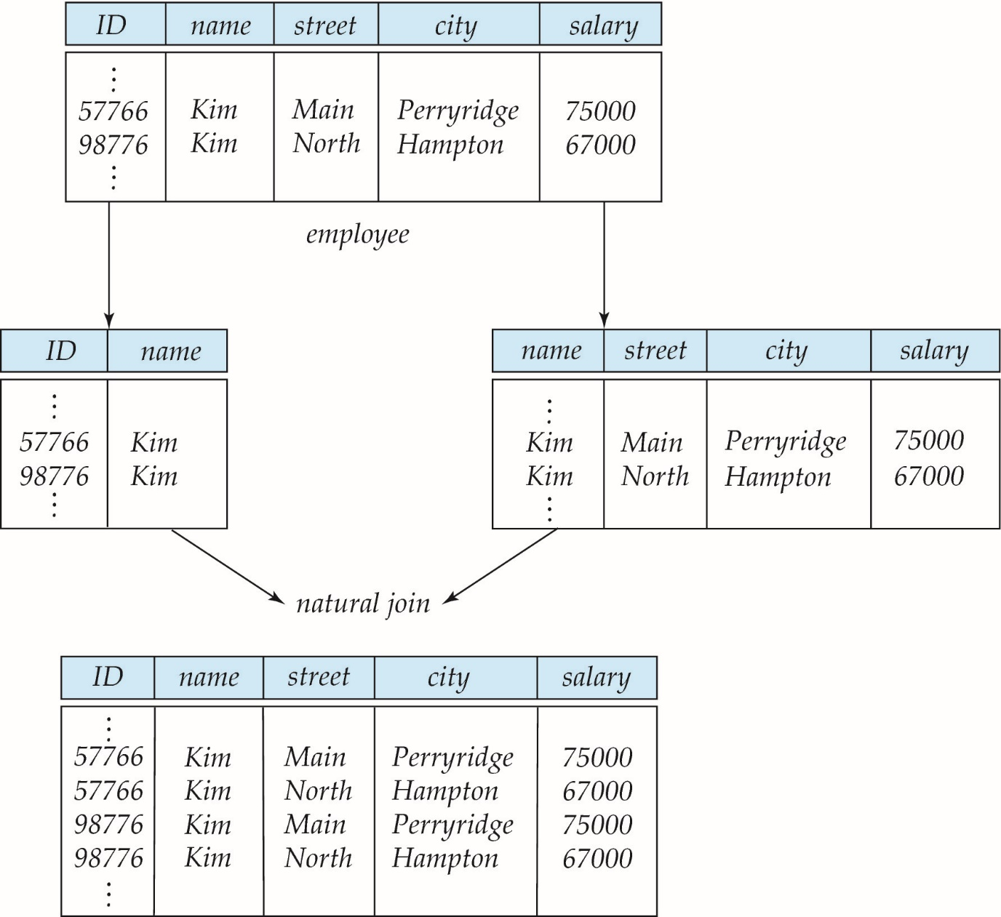
A Lossy Decomposition

Slide 12
Lossless Decomposition
Let R be a relation schema and let R₁ and R₂ form a decomposition of R . That is R = R₁ U R₂
We say that the decomposition is a lossless decomposition if there is no loss of information by replacing R with the two relation schemas R₁ U R₂
Formally,
∏ _{R1} (r) ∏ _{R2} (r) = r
And, conversely a decomposition is lossy if
  r ⊂ ∏ _{R1} (r) ∏ _{R2} (r)

Slide 13
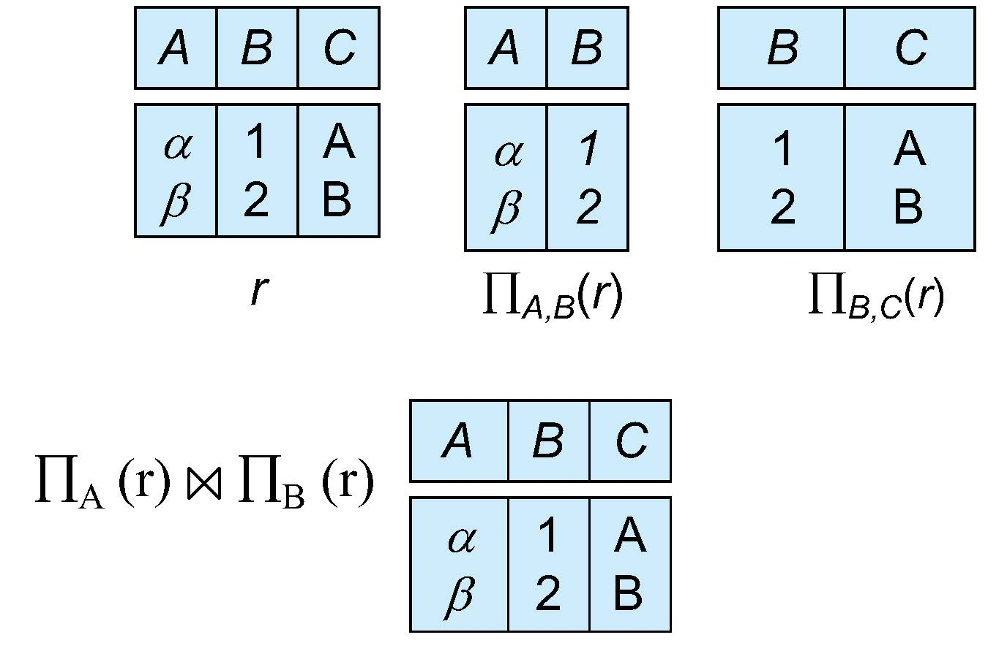
Example of Lossless Decomposition
Decomposition of R = (A, B, C)
R₁ = (A, B) R₂ = (B, C)

Slide 14
Normalization Theory
Decide whether a particular relation R is in “good” form.
In the case that a relation R is not in “good” form, decompose it into set of relations {R₁, R₂, ..., R_{n}} such that
  Each relation is in good form
  The decomposition is a lossless decomposition
Our theory is based on:
  Functional dependencies
  Multivalued dependencies
  Join Dependencies

Slide 15
Schema Refinement
Redundancy
Schema Refinement
  Minimizing Redundancy
  Functional Dependencies (FDs)
  Normalization using FDs
    First Normal Form (1NF)
    Second Normal Form (2NF)
    Third Normal Form (3NF)
    Boyce-Codd Normal Form (BCNF)
  Multivalued Dependencies (MVDs), Join Dependencies JDs)
  Normalization using MVDs and JDs
    Higher Normal Forms ( 4NF, 5NF)

Slide 16
Functional Dependencies
There are usually a variety of constraints (rules) on the data in the real world.
For example, some of the constraints that are expected to hold in a university database are:
  Students and instructors are uniquely identified by their ID.
  Each student and instructor has only one name.
  Each instructor and student is (primarily) associated with only one department.
  Each department has only one value for its budget, and only one associated building.

Slide 17
Functional Dependencies (Cont.)
An instance of a relation that satisfies all such real-world constraints is called a legal instance of the relation;
A legal instance of a database is one where all the relation instances are legal instances
Constraints on the set of legal relations.
Require that the value for a certain set of attributes determines uniquely the value for another set of attributes.
A functional dependency is a generalization of the notion of a key.

Slide 18
Functional Dependencies Definition
Let R be a relation schema
α ⊆ R and β ⊆ R
The functional dependency
α → β
holds on R if and only if for any legal relations r(R), whenever any two tuples t₁ and t₂ of r agree on the attributes α, they also agree on the attributes β. That is,
t₁[α] = t₂ [α] ⇒ t₁[β ] = t₂ [β ]
Example: Consider r(A,B ) with the following instance of r.
On this instance, B → A hold; A → B does NOT hold,
4
1 5
3 7

Slide 19
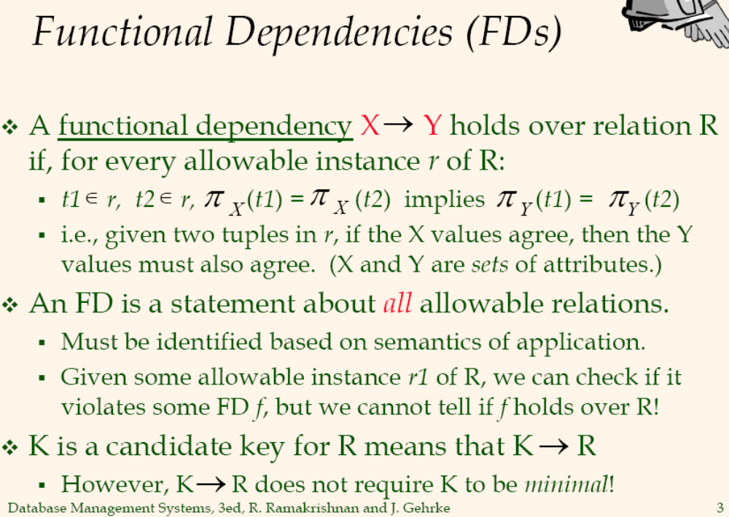

Slide 20
Closure of a Set of Functional Dependencies
Given a set F set of functional dependencies, there are certain other functional dependencies that are logically implied by F.
  If A → B and B → C, then we can infer that A → C
  etc.
The set of all functional dependencies logically implied by F is the closure of F.
We denote the closure of F by F⁺.

Slide 21
Keys and Functional Dependencies
K is a superkey for relation schema R if and only if K → R
K is a candidate key for R if and only if
  K → R, and
  for no α ⊂ K, α → R
Functional dependencies allow us to express constraints that cannot be expressed using superkeys. Consider the schema:
in_dep (ID, name, salary, dept_name, building, budget ).
We expect these functional dependencies to hold:
dept_name→ building
ID → building
but would not expect the following to hold:
dept_name → salary

Slide 22
Use of Functional Dependencies
We use functional dependencies to:
  To test relations to see if they are legal under a given set of functional dependencies.
    If a relation r is legal under a set F of functional dependencies, we say that r satisfies F.
  To specify constraints on the set of legal relations
    We say that F holds on R if all legal relations on R satisfy the set of functional dependencies F.
Note: A specific instance of a relation schema may satisfy a functional dependency even if the functional dependency does not hold on all legal instances.
  For example, a specific instance of instructor may, by chance, satisfy
  name → ID.

Slide 23
Trivial Functional Dependencies
A functional dependency is trivial if it is satisfied by all instances of a relation
Example:
  ID, name → ID
  name → name
In general, α → β is trivial if β ⊆ α

Slide 24
Lossless Decomposition
We can use functional dependencies to show when certain decomposition are lossless.
For the case of R = (R₁, R₂), we require that for all possible relations r on schema R
r = ∏_{R1} (r ) ∏_{R2} (r )
A decomposition of R into R₁ and R₂ is lossless decomposition if at least one of the following dependencies is in F⁺:
  R₁ ∩ R₂ → R₁
  R₁ ∩ R₂ → R₂
The above functional dependencies are a sufficient condition for lossless join decomposition; the dependencies are a necessary condition only if all constraints are functional dependencies

Slide 25
Example
R = (A, B, C)
F = {A → B, B → C)
R₁ = (A, B), R₂ = (B, C)
  Lossless decomposition:
  R₁ ∩ R₂ = {B} and B → BC
R₁ = (A, B), R₂ = (A, C)
  Lossless decomposition:
  R₁ ∩ R₂ = {A} and A → AB
Note:
  B → BC
  is a shorthand notation for
  B → {B, C}

Slide 26
Dependency Preservation
Testing functional dependency constraints each time the database is updated can be costly
It is useful to design the database in a way that constraints can be tested efficiently.
If testing a functional dependency can be done by considering just one relation, then the cost of testing this constraint is low
When decomposing a relation it is possible that it is no longer possible to do the testing without having to perform a Cartesian Produced.
A decomposition that makes it computationally hard to enforce functional dependency is said to be NOT dependency preserving.

Slide 27
Dependency Preservation Example
Consider a schema:
dept_advisor(s_ID, i_ID, department_name)
With function dependencies:
i_ID → dept_name
s_ID, dept_name → i_ID
In the above design we are forced to repeat the department name once for each time an instructor participates in a dept_advisor relationship.
To fix this, we need to decompose dept_advisor
Any decomposition will not include all the attributes in
s_ID, dept_name → i_ID
Thus, the composition NOT be dependency preserving

